Slide 1
HFFA Membership Study Results Wave 2
October 2018

Slide 2
Response rate increased by more than 20%
This should be compared to the membership numbers, emails sent and channels used
Survey launched October 8 and closed October 22
We received a total of 333 responses which derives a 95% confidence interval at +/- 10%
 | 2017 | 2018 | Change
Surveys Started | 396 | 438 | +11%
Surveys Completed | 275 | 333 | +21%
% who Started | 69% | 76% | --
Source: HFFA Membership Survey, W1, September-October 2017 / W2, October 2018

Slide 3
Respondents skewed heavily female in both years
The 2017 base level membership was more evenly split at 52% female and 48% male
Source: HFFA Membership Survey, W1, September-October 2017 / W2, October 2018

Slide 4
The respondent base skews a bit younger in 2018
But majority of respondents (55%) are from the 50+ age group.
Source: HFFA Membership Survey, W1, September-October 2017 / W2, October 2018

Slide 5
Membership tenure in 2018 skews a bit lower
In contrast to 2017, where longer tenure members made up the majority of the respondents, the 2018 respondents consisted of shorter tenure or even newer members.
7%
39%
Source: HFFA Membership Survey, W1, September-October 2017 / W2, October 2018

Slide 6
Over 70% of respondents visit frequently, little change from 2017
Leads to assumption members are “clued into” what they see every day and feedback from heavy users is usually considered valid.
7%
Source: HFFA Membership Survey, W1, September-October 2017 / W2, October 2018

Slide 7
SURVEY RESULTS

Slide 8
Management Summary of HFFA
Improvement across the board with continued desire to compete as a fitness center
In both years, the data supports HFFA as a budget friendly Fitness Center first and foremost
HFFA Strong program occupied a significant amount of the feedback
Still a desire for more functional training classes, varied by time and skill level
“Wellness” programs around nutrition, healthy eating are still of interest but less pronounced vs. YA
Great progress across all data points in the survey, both quantitatively and in the comments
Respondents skewed younger, lower tenure
Staff continues to capture highest satisfaction marks
Widespread agreement around an improved experience
NPS improves by +20 points, with a shrinking population of “passives”
The big “ask” from Members appears to be around keeping the facility updated, renovated and clean
A seemingly limited or faded interest in ‘ancillary’ programs around Seniors, Children and even aquatics

Slide 9
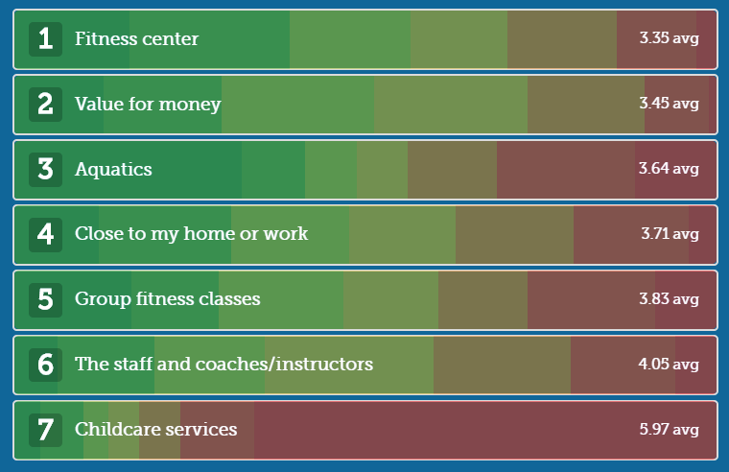
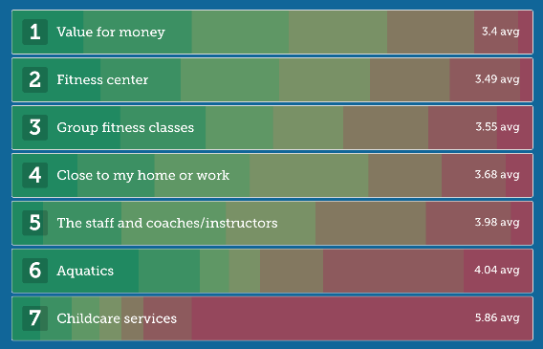
Membership continues to be driven by convenience, value and fitness
Across the board, the larger majority of HFFA members see the facility as a convenient fitness option at a good value. Aquatics fell in the member ranking, replaced by group fitness classes.
Question 1: What are the most important elements of HFFA to you? Respondents asked to drag in order of most important to least important.
Source: HFFA Membership Survey, W1, September-October 2017 / W2, October 2018

Slide 10
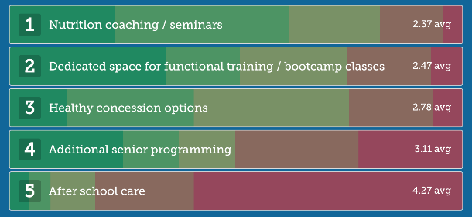
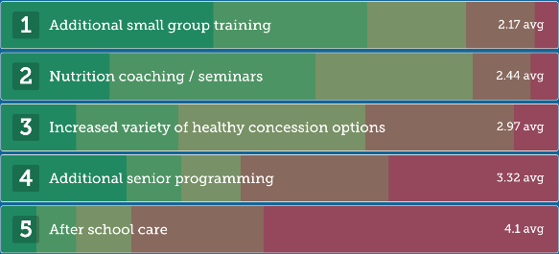
Adding group training options and nutrition are of most interest
There is little change to the ranking of what members see as important adds to the facility’s programming – the responses are largely focused on good nutrition (classes, concessions) and smaller group training.
Question 2: In considering the potential of new programs, please let us know which of the following would be of interest to you. Respondents dragged the options in order of importance.
Source: HFFA Membership Survey, W1, September-October 2017 / W2, October 2018

Slide 11
Satisfaction metrics are up across the board
In both years of the study, the Staff/Instructors/Coaches earn the highest satisfaction marks from members. Children’s services remained essentially flat.
Question 3: Next, we would like you to rate your satisfaction with each of the following elements of the facility. Respondents were asked to rank each element from 1-5 stars, 5 being highest
Source: HFFA Membership Survey, W1, September-October 2017 / W2, October 2018

Slide 12
Membership agrees that additions have been beneficial
Nearly 80% of the respondents registered some level of agreement that HFFA has provided an improved offering of classes and overall member experience in the last year.
Question 4: Over the past year, HFFA has improved the program offerings and member experience. Respondents were asked to rate their level of agreement with the statement.
Source: HFFA Membership Survey, W1, September-October 2017 / W2, October 2018 (question not fielded in W1)

Slide 13
Members still believe you are priced fairly…
Price perception has migrated to the mid-line in 2018, whereas in 2017 it was perceived just slightly higher.
“A Steal”
“Too Expensive”
2017 = 55.7
2018 = 51.0
Vitality = 59.7
Question 5: My membership is a good value. Respondents were asked to use a sliding scale.
Source: HFFA Membership Survey, W1, September-October 2017 / W2, October 2018

Slide 14
Results, value and facility quality are the Top 3 most important
There is little change to the “order” of the most important elements to members which is a good result in terms of executing a growth plan for the facility.
Question 6: How important are each of the following reasons when thinking about your membership? Respondents were asked to rate each on a scale of 1-5, 5 being highest.
Source: HFFA Membership Survey, W1, September-October 2017 / W2, October 2018

Slide 15
The NPS measure for HFFA has improved dramatically
NPS is a measure of customers’ overall loyalty to your business. The score is calculated by taking the percentage of respondents who are Promoters (Scores 9-10) and subtracting the percentage of respondents who are Detractors (Scores 0-6). No credit is given for those classified as Neutrals (Scores 7-8) This will generate a score ranging from -100 to 100, which is your Net Promoter Score.
NPS = 27
NPS = 47
NPS = 93
Question 7: How likely are you to recommend us? Respondents were asked to choose on a scale of 1-10.
Source: HFFA Membership Survey, W1, September-October 2017 / W2, October 2018

Slide 16
The HFFA Strong program is rated best new addition
The new boot camp program by far captures the rating as the best addition. However, based on the comments section, there is likely some work to be done around programming, timing and equipment usage
Question 8: What changes have been most beneficial to your experience at HFFA over the last year? Respondents were asked to choose an option from the selection.
Source: HFFA Membership Survey, W1, September-October 2017 / W2, October 2018

Slide 17
Quality and budget remain primary driver of renewal
65% of respondents chose the quality of the staff, facility and their own budget as the drivers of their renewal decision. A lower percentage use achieving results as a driver of the renewal decision, though that occupies the most important element in other multi-option rankings.
 | 2017 | 2018 | Change
Quality of staff and facility | 34% | 35% | +3%
Budget | 28% | 30% | +7%
Ability to Obtain Results | 18% | 18% | --
Other commitments | 11% | 8% | -27%
Other/not listed | 9% | 9% | --
Question 9: What is the most important factor that drives your decision when it's time to maintain your membership? Respondents were asked to pick only 1 factor.
Source: HFFA Membership Survey, W1, September-October 2017 / W2, October 2018

Slide 18
Next Steps
Determine need for additional analysis based on initial results
Socialize results with staff and members – using recommendations
Further analyze the verbatims by members

